Slide 1
CD DevOps review
Ziv
FEB 2021

Slide 2

Overview
SEMurai project structure
SEMurai build Dev methodology
Continuous integration workflow
Continuous delivery workflow
Ongoing projects
Text in box with highlighted words

Slide 3
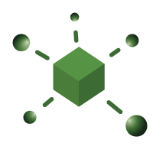




SEMurai project structure
SEMuria software parts :
Infrastructure , MC, IP and FIFA
SEMurai repository includes ~160 solutions
The project development is done with C# (4.7.2 framework), C++, Python (3.6.8) and MATLAB
The project compiled with Nant (similar to Ant, Maven)
It includes nuggets dependencies and 3rd party (in Python) projects that takes from Nexus Prod artifactory server

Slide 4





SEMurai build Dev methodology
Source control :Git managed by Bitbucket
Git clients: SourceTree, Git extensions
IDEs: VS2017, PyCharm, Rider
Build servers : Jenkins Dev, Jenkins Prod, Jenkins DSL (In progress)
Artifact's repository: Nexus Prod

Slide 5


SEMurai build Dev methodology
Today CD SEMuria project have 4 main versions,
each version has a main branch :
V2.9.20/main, v2.9.30/main ,v3.0.40/main ,vNext/main(master)
To start work on a new feature or bug we (git)checkout from the relevant main branch to development branch and merge back the code to the main branch.

Slide 6
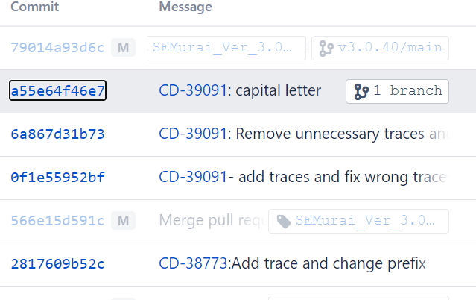

SEMurai build Dev methodology
Sample:
Checkout from v2.920/main -> v2.9.20/dev/CD-1234_new_feature
Coding -> commit all changes.
Commit message includes Jira ticket number: "CD-1234: commit message"
Push the Dev branch to origin (remote server)
Open Pull request.
* Jira ticket number is a reference id that used for integration
between Bitbucket, Jira and confluence

Slide 7
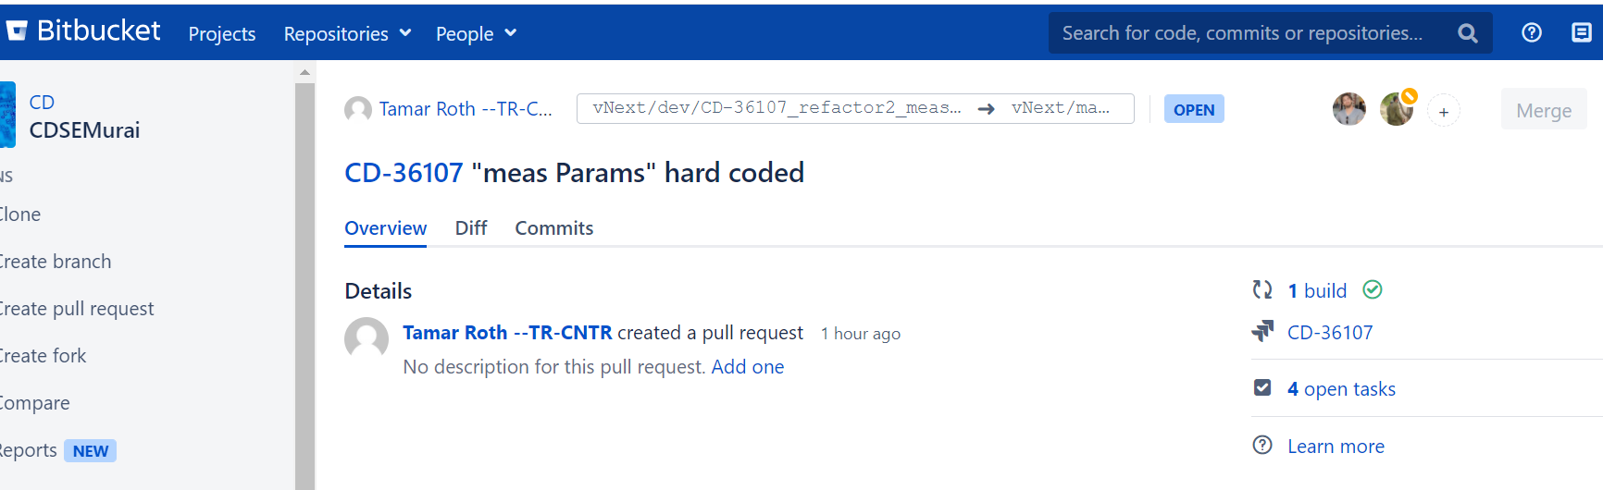
Continuous integration workflow
Pull request:

Slide 8
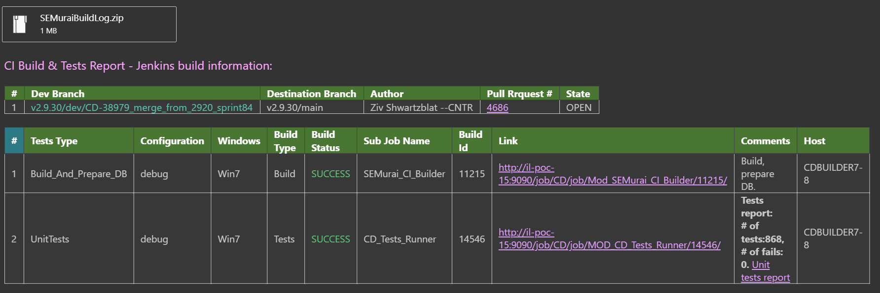
Continuous integration workflow
Pull request includes code review , tasks and CI build
Every pull request triggers a Jenkins job that run on parallel on few servers , it is merging the Dev branch with the main (destination) branch into temporary integration branch,
Runs build , create DB and run unit tests and sends email report

Slide 9
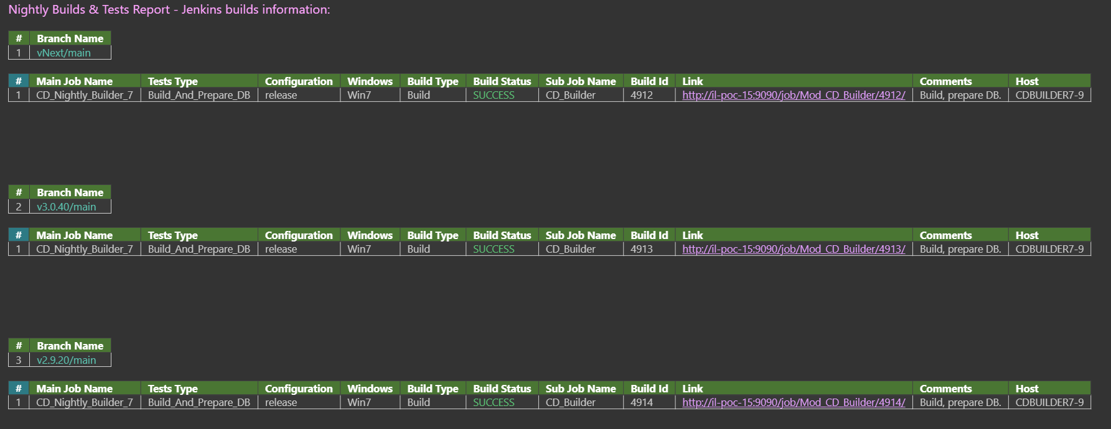
Continuous integration workflow
Nightly builds runs every night on all relevant versions , sending report email in the morning

Slide 10
Continuous delivery workflow
Automatically triggered on daily base or manually
Version creation steps are:
Compiles the version code
Creates installer
Tags (git) the version
Sending the installer to shared folder and Nexus

Slide 11
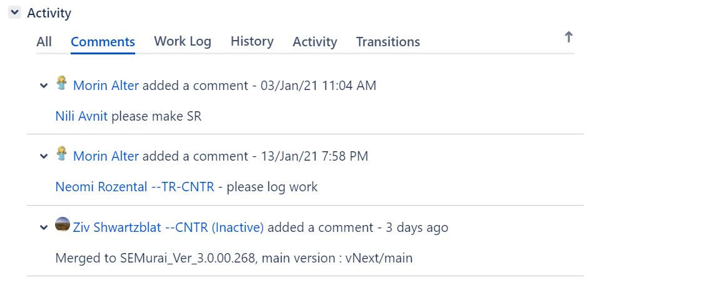
Continuous delivery workflow
Add comment in Jira issue
(based on the reference id - Jira ticket number),
Sending information to automation's nightly runs that collect the version and run the tests on it

Slide 12
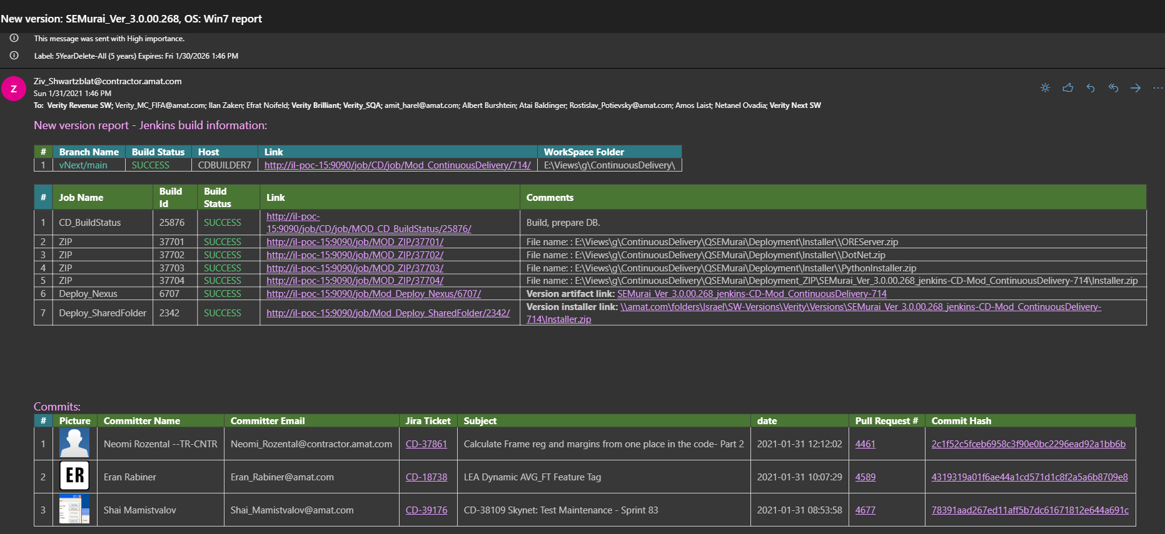
Continuous delivery workflow
Sending version report email with Jira USs

Slide 13
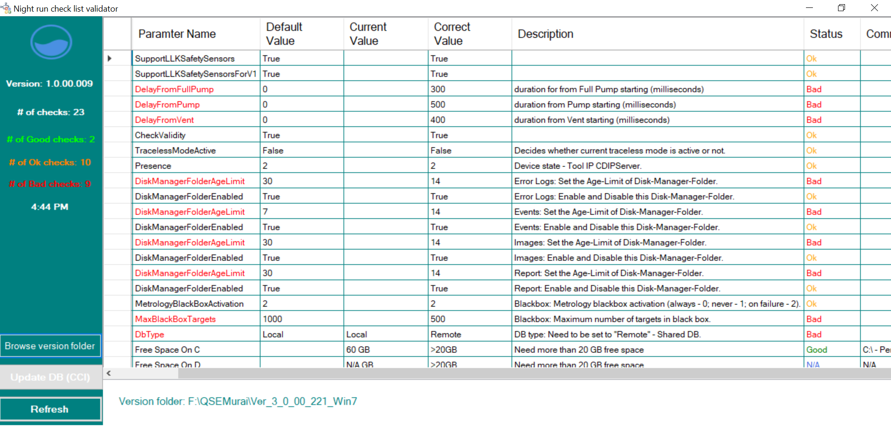
Ongoing projects
Improve NR validator tool - CCI, Tool environment parameters validation

Slide 14
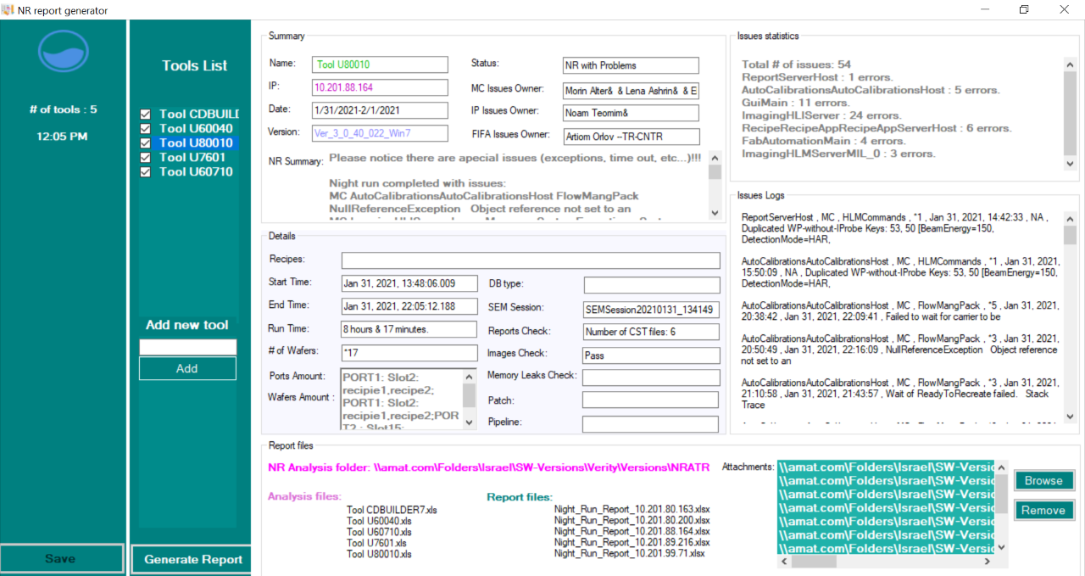
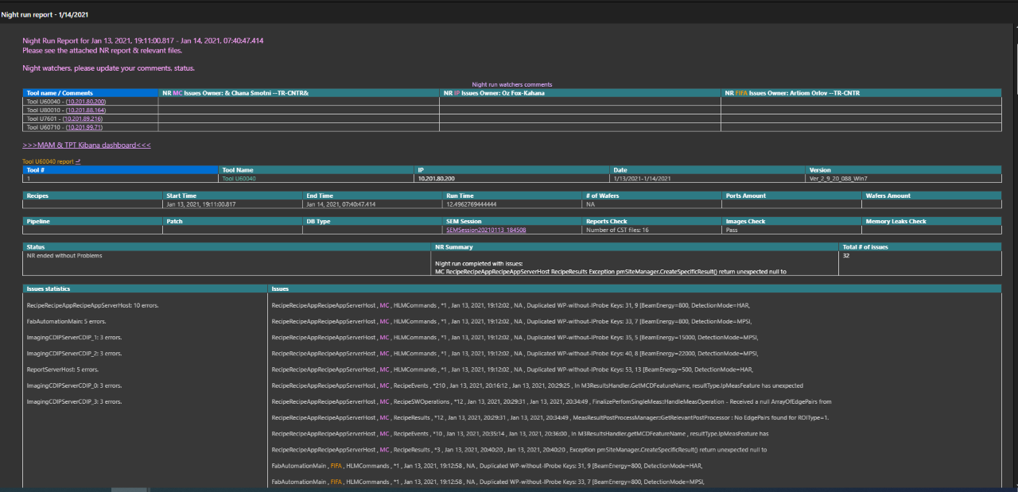
Ongoing projects
Generate NR report automatically

Slide 15
Ongoing projects
Implement jobs in Jenkins DSL
Auto-merge
Integrate between automation report and Jira USs (bug status)
Visual studio 2019
SQL server 2017
Run integration tests on Docker
Prism (3rd party python components)
Software center – fully automatic installers (VS 2017, Matlab runtime, etc.)

Slide 16
Q&A

